Slide 1
Introduction to Computer Science (371-1-1601)
Lectures by: Dr. Dan Vilenchik & Dr. Zion Siksik
Recitations by: Ariel Cohen, Moshiko Davidian, Assaf Livne, Yair Mazal

Slide 2
Recitation 12 Binary Search, GCD

Slide 3
Todays topics
Binary search
Gcd

Slide 4
Searching problem statement
Let be a sorted list and a value. We would like to find the index of the value in the sorted list.
def naive_search(arr,value): for idx, num in enumerate(arr): if num == value: print('found it! index={}’.format(idx)( break

Slide 5

Binary search
Compare the value to the middle element of the list. If they are not equal, the half in which the target cannot lie is eliminated and the search continues on the remaining half.
Worst case: $\left\lfloor \log_{2}{n}+1\right\rfloor$

Slide 6
Binary search - algorithm
Compare the value to the middle of the list. It is equal the search is over
If the value is higher, repeat step 1 for all of the higher indexes of the list. If the value is lower, repeat step 1 for all of the lower indexes of the list.

Slide 7
Binary search – example
value
5
1
3
5
8
9
12
15

Slide 8
Binary search – example
Compare the value to the middle of the list. If it is equal the search is over.
value
5
1
3
5
8
9
12
15

Slide 9
Binary search – example
If it is lower all the right values are eliminated from the search.
If it is higher all the left values are eliminated from the search.
value
5
1
3
5
8
9
12
15

Slide 10
Binary search – example
Compare the value to the middle of the list. If it is equal the search is over.
value
5
1
3
5
8
9
12
15

Slide 11
Binary search – example
If it is lower all the right values are eliminated from the search.
If it is higher all the left values are eliminated from the search.
value
5
1
3
5
8
9
12
15

Slide 12
Binary search – example
Compare the value to the middle of the list. If it is equal the search is over.
value
5
1
3
5
8
9
12
15

Slide 13
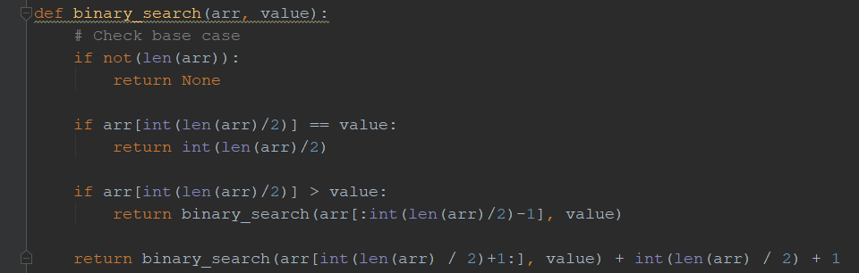
Binary search – code

Slide 14
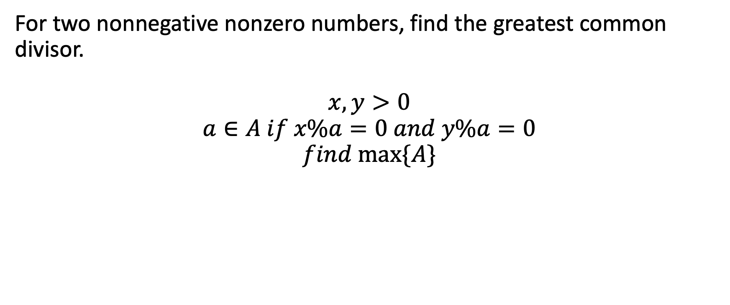
Greatest Common Divisor (GCD)
For two nonnegative nonzero numbers, find the greatest common divisor. $$x,y>0$$
$$a∈A if x\%a=0 and y\%a=0$$
$$find max⁡\{A\}$$

Slide 15
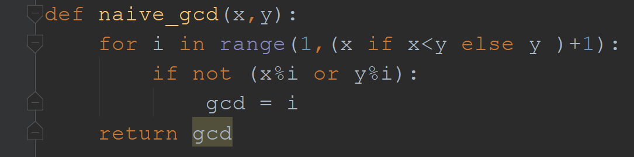
Solution 1 – naïve solution

Slide 16
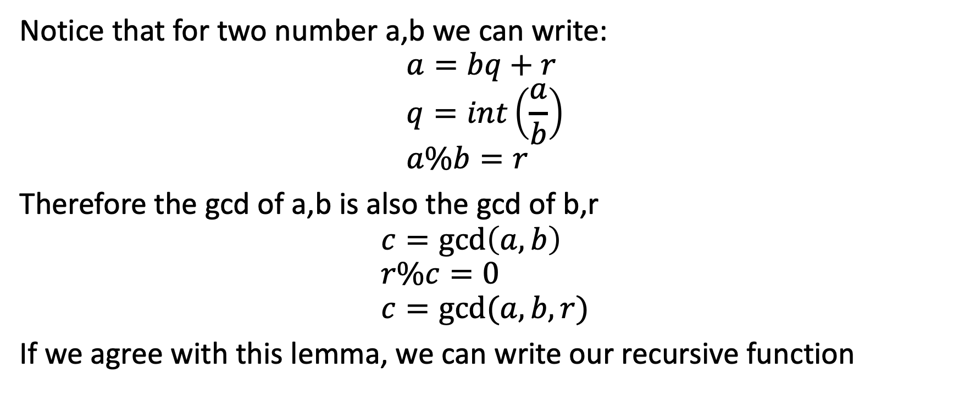
Solution 2 – recursive solution
Notice that for two number a,b we can write:
$$a=bq+r \\ q=int\left(\frac{a}{b}\right) \\ a\%b=r$$
Therefore the gcd of a,b is also the gcd of b,r
$$c=\gcd\left(a,b\right) \\ r\%c=0 \\ c=gcd⁡(a,b,r)$$
If we agree with this lemma, we can write our recursive function

Slide 17

$$a_{1}=36 \\ b_{1}=24 \\ 36=24∗1+12$$
$$a_{2}=24 \\ b_{2}=12 \\ 24=2∗12+0$$

Slide 18
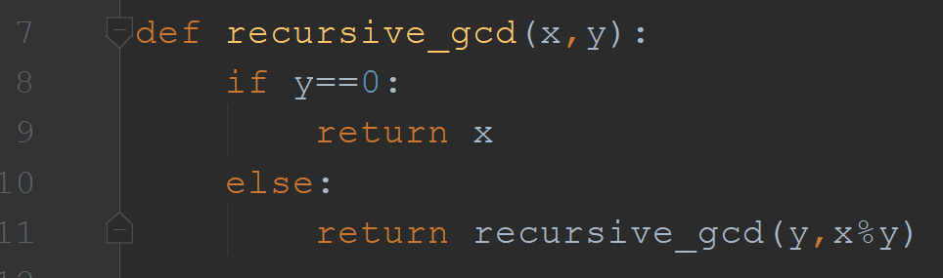
Solution 2 – recursive solution

Slide 19
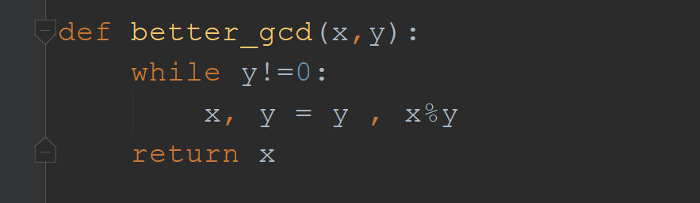
Solution 3 – non-recursive better solution

Slide 20

Solution 4 – maybe math is better?

Slide 21
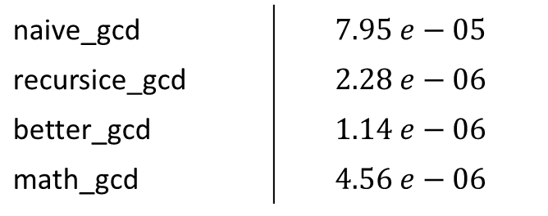
Lets compare the different run-time
naive_gcd | $$7.95 e−05$$
recursice_gcd | $$2.28 e−06$$
better_gcd | $$1.14 e−06$$
math_gcd | $$4.56 e−06$$

